Slide 1
GM系列起动机开发
GM Starters Developing
北京佩特来电器有限公司
Prestolite Electric (Beijing) Ltd.

Slide 2
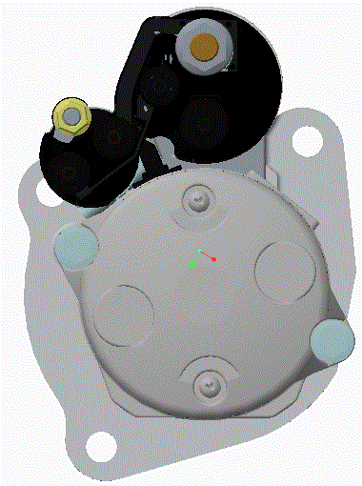
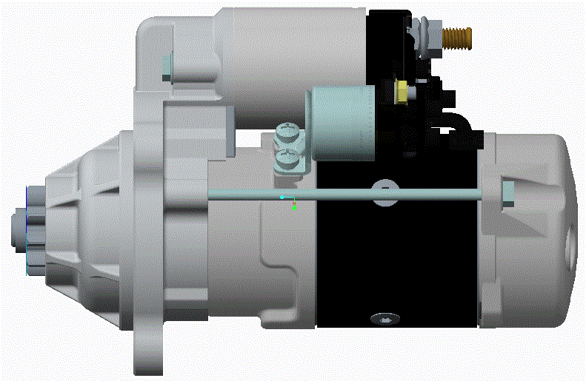
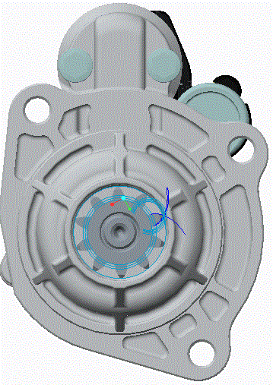
GM 起动机 GM Starter
更轻、更小、更快、更可靠
Lighter 、Smaller、 Faster、 More reliable

Slide 3
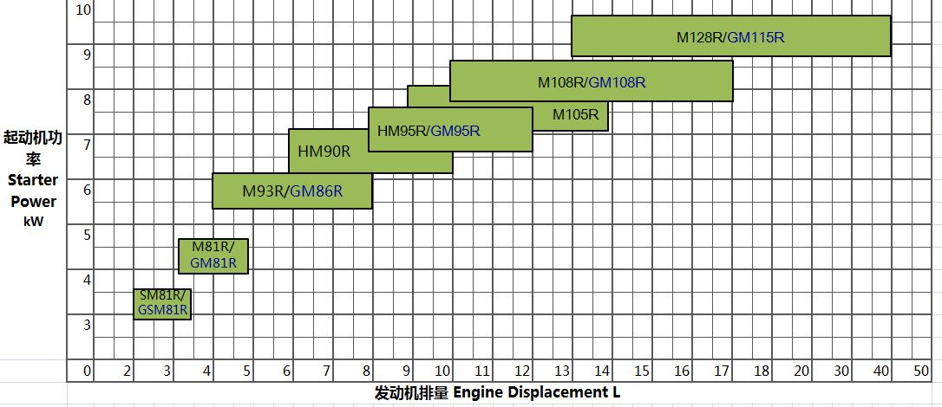
型谱 Type spectrum
2

Slide 4
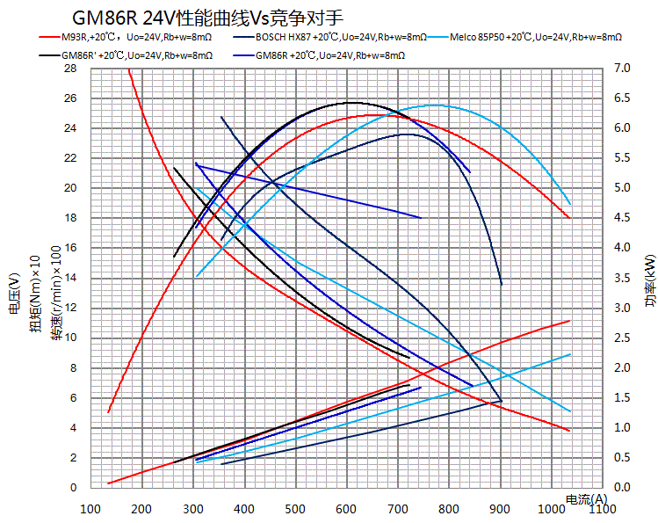
性能 Performance
功率与普通起动机相同
Power will be sample as normal starters
3

Slide 5
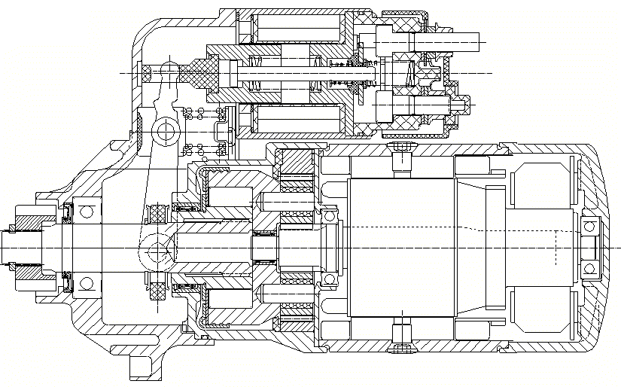
基本特征 Basic feature
行星减速
Planetary Gear Reduction
无鼻
No nose
高/全密封
High/Full-sealing
湿式飞轮
Wet flywheel
单向器只旋转
The Drive Assembly rotate only
4

Slide 6
基本信息 Basic information
24V 6 kW@8mΩ
4-8L中型柴油发动机
4-8L Medium duty diesel engine
6.2 kg
定子直径86mm
The stator diameter : 86mm
总长246mm
The total length : 246mm
防护等级IP56（IPX7和IP69可选）
Protection Level:IP56 (IPX7 and
IP69 is also optional)
-40~120℃
干式和湿式飞轮壳
Dry and wet flywheel housing
蓄电池150~225Ah（最大CCA=1400A）
The battery ：150~225Ah（the max CCA was1400A）
齿轮距齿圈1-6mm
The distance between gear and gear ring : 1-6mm
5

Slide 7
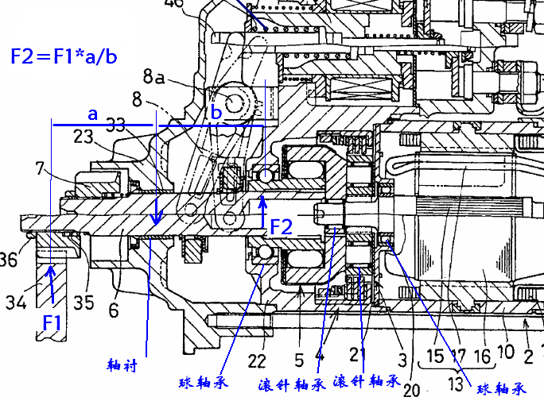
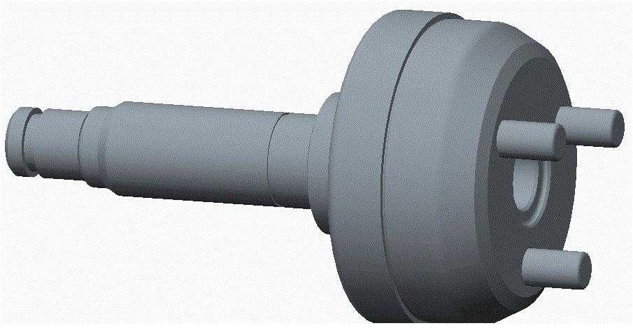
GM技术特点------单向器只旋转
GM technical character --- Drive Assembly rotated only
F=F1+F2=F1*(1+a/b)
此设计零件少,轴受力小,能降低整机重量和制造成本.
For this design the axial force is smaller and the part is smaller which can reduce the weight of the whole machine and manufacturing cost
6

Slide 8
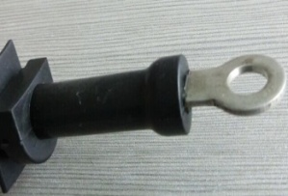
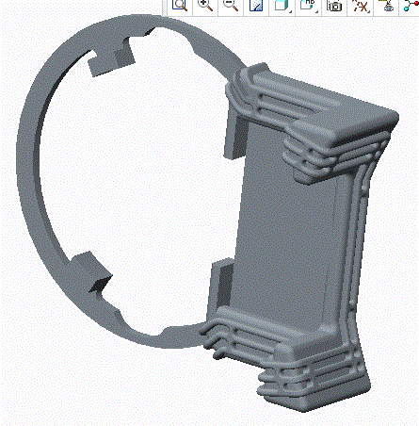
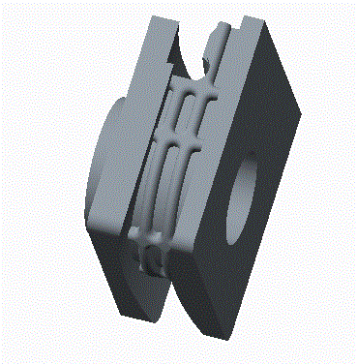
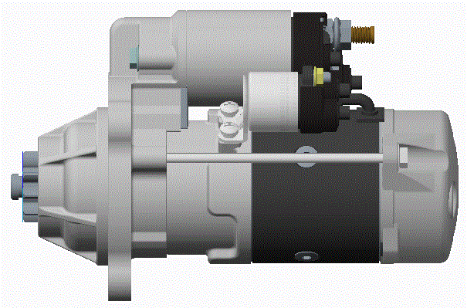
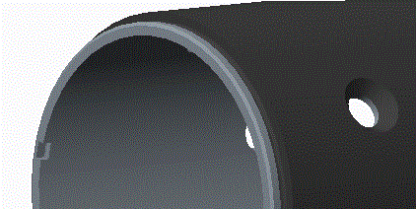
GM技术特点------高密封/全密封
GM technical character --- High - sealing / Full - sealing
四大漏水点设计,提高密封可靠性
Four leakage point design :improve the reliability of sealing
驱动端盖和电刷端盖取消排水槽+整机密封测试=全密封
The full seal: cancel the drain slot in nose housing and brush end cover meanwhile coordinate with the whole machine seal test
7

Slide 9
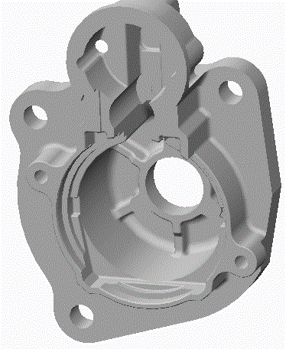
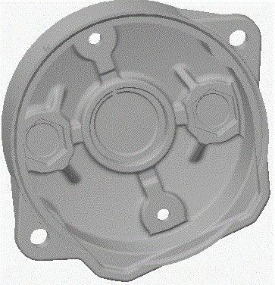
GM技术特点------多槽排水
GM technical character ------Multiple-grooved drainage
排水范围:覆盖最低点在电磁开关正下方+/-70°范围
Drainage range: the covered lowest point was +/-70 degree below the switch
极大减少起动机变型数量,减少起动机零件号,节约成本
Greatly reduce the number of variant starter ;reduce starter part number ;
8

Slide 10
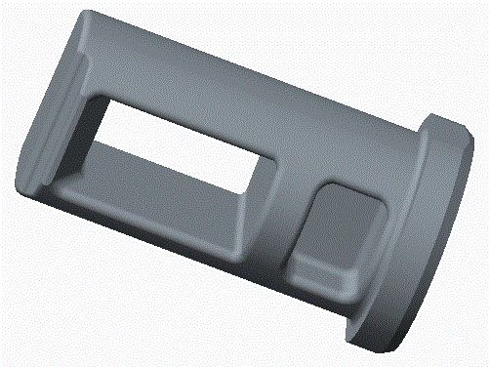
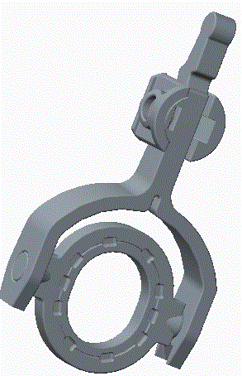
GM技术特点------低磨损标准件
GM technical character---- low worn standard parts
尼龙拉杆
Nylon rod
尼龙拨叉
Nylon Lever
球轴承
Ball bearing
提高摩擦副可靠性
Improve the reliability of friction pair
滚针轴承
Needle Bearing
9

Slide 11
数据对比 Data comparison
参数 型号Starter | M93R | GM86R | 相比
重量Weight（kg） | 10 | 6.2 | -38%
直径Diameter（mm） | 93 | 86 | -7.5%
长度Length（mm） | 282 | 246 | -12.8%
功率Performance（kW） | 6.2 | 6.2 | 0%
耐久（次）Endurance (cycles) | 35,000 | 50,000 | +42.9%
10

Slide 12
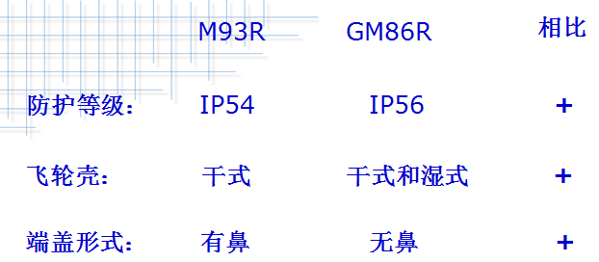
特征对比 Fcomparison
Comparison
IP grade
Fly wheel
Dry
Dry & wet
Drive housing
Nosed housing
Noseless housing
GM86R性能与M93R相同
GM86R’s performance is same as M93R
GM86R在耐久寿命、环境适应性方面有大幅提升
GM86R is much better on endurance and environment adaptability
GM86R比M93R长度短、重量轻适应发动机轻量化设计
GM86R is shorter and lighter than M93R, It is very good for engine lightweight design.
11

Slide 13
专利 Patents
已申请7个发明专利，4个实用新型，3个外观
Applying 7 patents of invention , 4 patents for utility models, 3 patents of appearance
12

Slide 14
谢谢！ Thank you!
Prestolite Electric (Beijing) Limited

